Slide 1
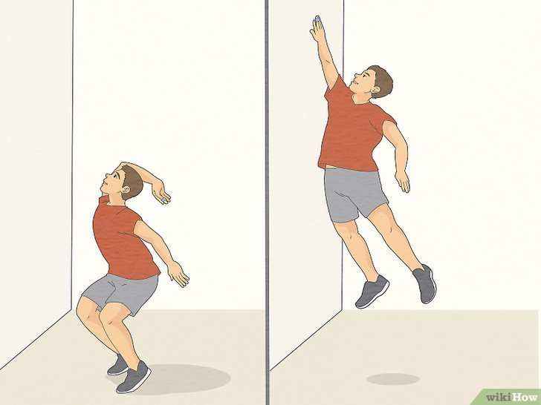
Can your warm up stretch affect your explosive performance?
Research on different stretch modalities on vertical jump performance

Slide 2
Vertical Jump Research
This study explores factors influencing vertical jump height for improved athletic performance.

Slide 3
Muscle power development
Strengthening leg muscles enhances vertical leap efficiency and height.
Flexibility training benefits
Improving flexibility aids in achieving greater jump heights effectively.
Coordination and timing strategies
Proper timing during jumps maximizes height and overall performance potential.

Slide 4
Investigating Factors Affecting Vertical Jump Height Performance
A Comprehensive Study on Athletic Performance Enhancements

Slide 5
Stretching and Jumping
Research shows stretching significantly improves vertical jump performance in athletes.
Enhancing athletic performance effectively.

Slide 6
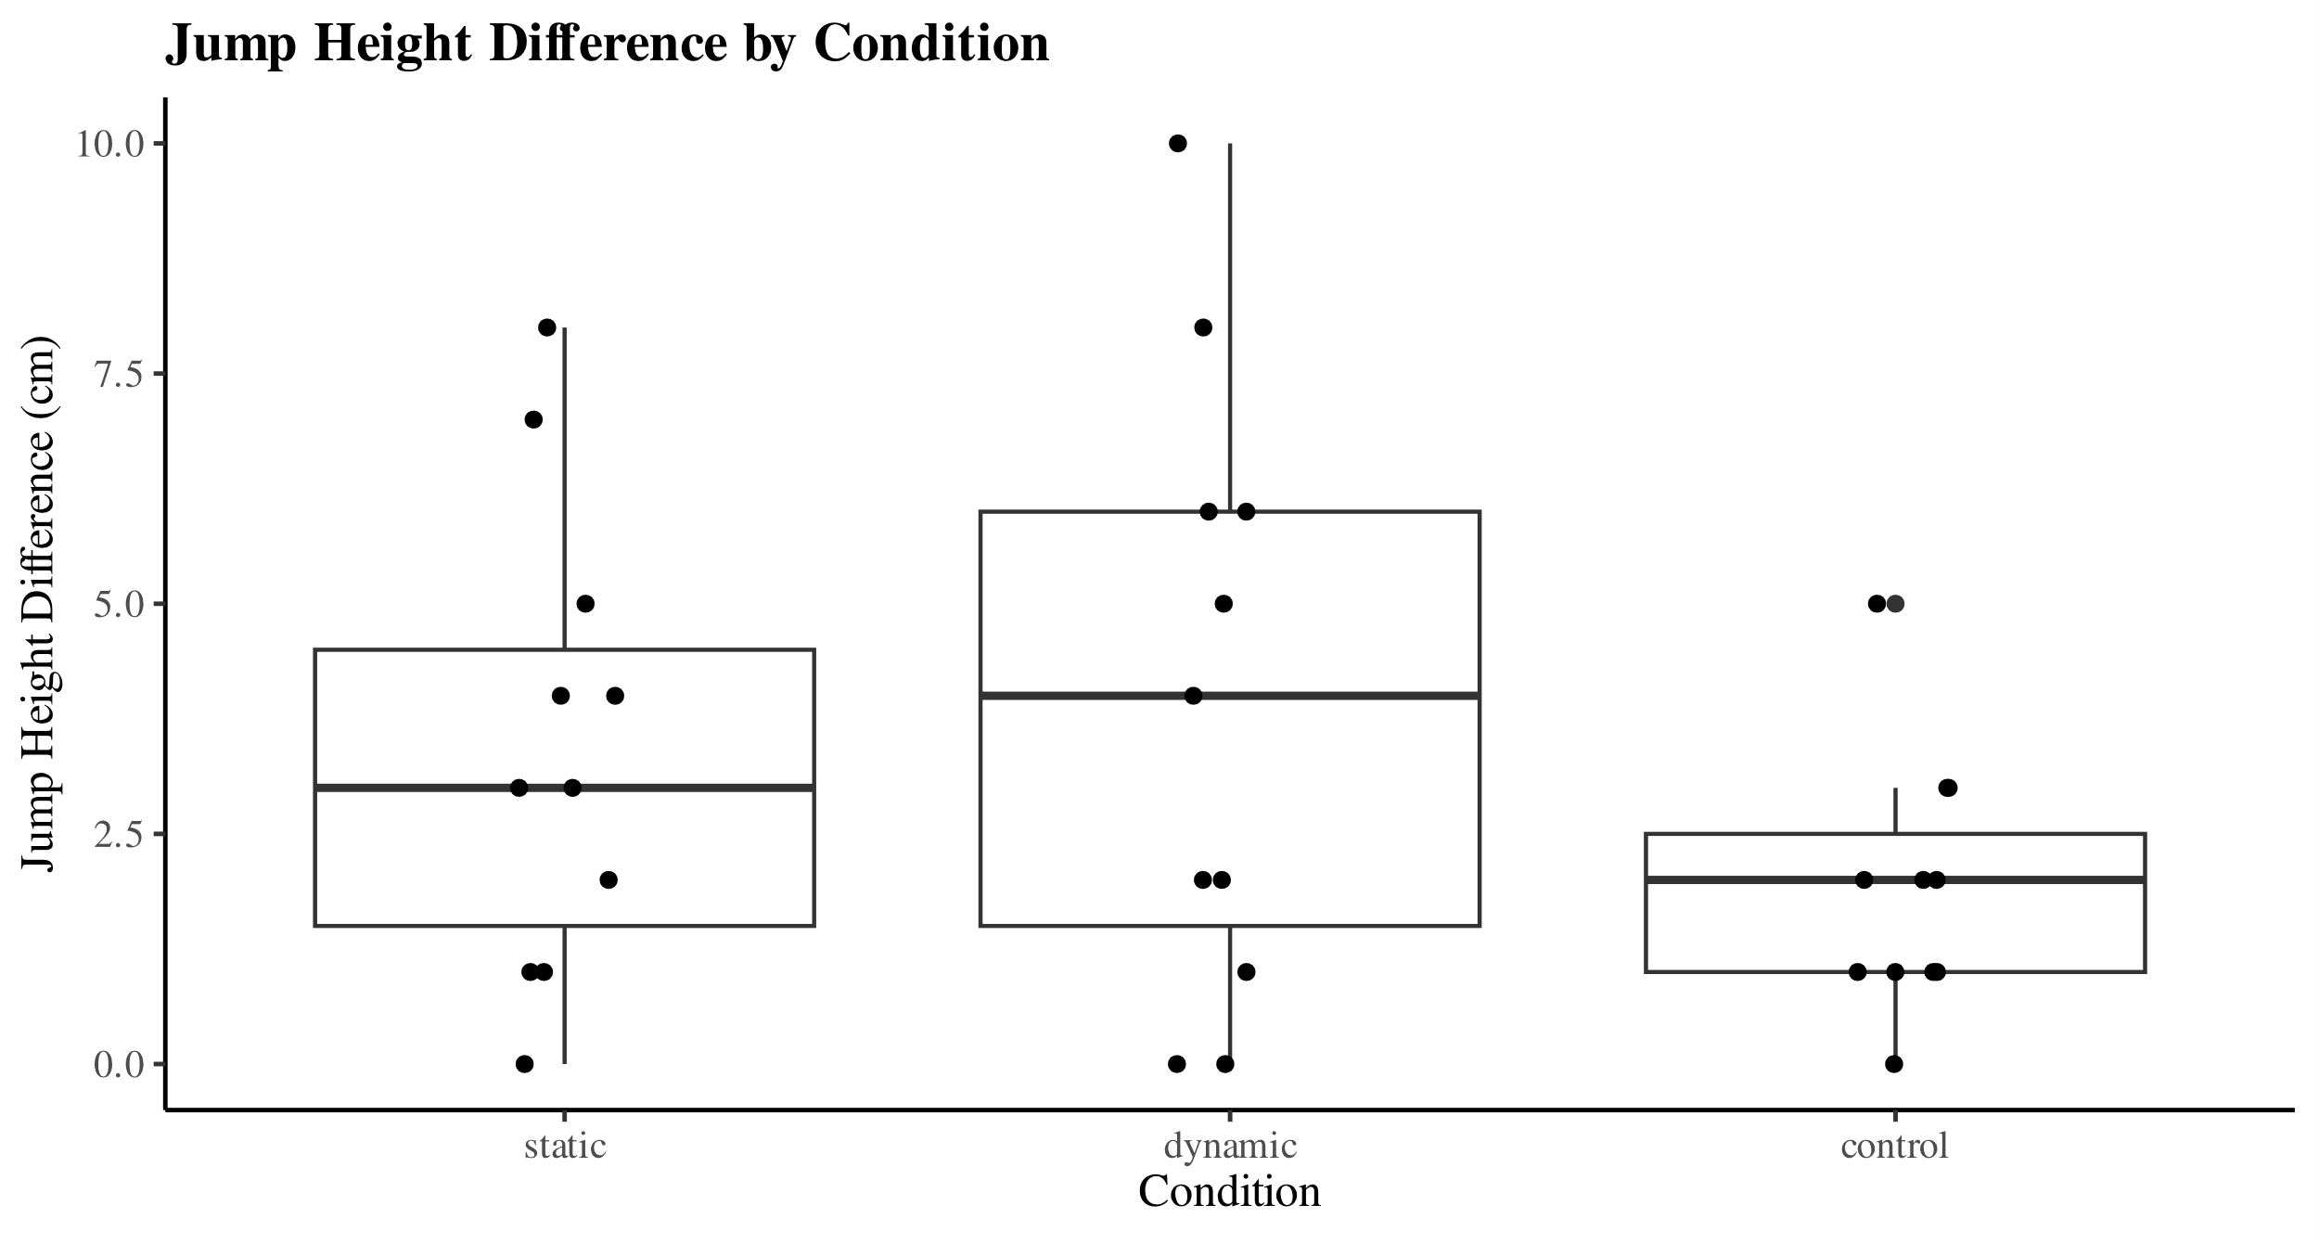
*
Dynamic stretching significantly improves vertical jump height compared to static stretching not stretching, enhancing explosive performance in athletes.
Notes:
Overall findings
Any relevant information

Slide 7
Understanding the Mechanics of Vertical Jumping
Vertical jump height is influenced by strength, flexibility, and technique throughout the training process.

